Slide 1



Software Development lifecycles

Slide 2

Notes:
Building a House:
1- First, the owner describes the vision for the house to the developer.
2- Second, this idea is transformed into sketches and drawings that are shown to the owner and refined
(often, through several drawings, each improving on the other) until the owner
agrees that the pictures depict what he or she wants.
3- Third, a set of detailed blueprints is developed that presents much more specific information about the house. (e.g., the layout of rooms, placement of plumbing fixtures and electrical outlets, and so on).
4- Finally, the house is built following the blueprints—and often with some changes and decisions made by the owner as the house is erected.

Slide 3

What is Software Development Life Cycle (SDLC) ?
is the set of processes and corresponding tasks used to develop and deliver high quality software.

Slide 4
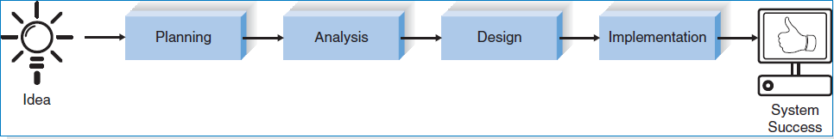
Four fundamental phases for Building an Information System :
Notes:
Each phase is itself composed of a series of steps, which rely on techniques that
produce deliverables (specific documents and files that explain various elements of
the system).

Slide 5

Planning
Why and How to develop a software ?
Notes:
Most ideas for new systems come from outside the IS area (from the marketing department, accounting
department, etc.) in the form of a system request. A system request presents a
brief summary of a business need, and it explains how a system that supports the
need will create business value.
System Request
A system request is a document that describes the business reasons for building a
system and the value that the system is expected to provide. The project sponsor
usually completes this form as part of a formal system project selection process
within the organization. Most system requests include five elements: project sponsor,
business need, business requirements, business value, and special issues. (See
Figure 1-4.) The sponsor describes the person who will serve as the primary contact

Slide 6
Project Plan
is a formal document designed to guide the control and execution of a project. A project plan is the key to a successful project and is the most important document that needs to be created when starting any business project.

Slide 7
Project Plan
Understanding
Why an information system should be developed
Creating a plan for how the project team will develop it.
& deliver a project plan.

Slide 8

Feasibility Study
■ The technical feasibility (Can we build it?)
■ The economic feasibility (Will it provide business value?)
■ The organizational feasibility (If we build it, will it be used?)

Slide 9

Output
Project Plan
Feasibility Study
System Request

Slide 10
System Request
A system request is a document that describes the business reasons for building a system and the value that the system is expected to provide.
Notes:
The project sponsor usually completes this form as part of a formal system project selection process within the organization.

Slide 11
Most system requests include five elements:
Project sponsor
Business need
Business requirements
Business value and special issues.

Slide 12
Feasibility Study
Technical Feasibility: Can We Build It?
Familiarity with application: Less familiarity generates more risk.
Familiarity with technology: Less familiarity generates more risk.
Project size: Large projects have more risk.
Compatibility: The harder it is to integrate the system with the company’s existing technology, the higher the risk will be.
Economic Feasibility (cost–benefit analysis): Should We Build It?
Development costs
Annual operating costs
Annual benefits (cost savings and/or increased revenues)
Intangible benefits and costs
Organizational Feasibility: If We Build It, Will They Come?
Project champion(s)
Senior management
Users
Other stakeholders
Is the project strategically aligned with the business?
Notes:
Although we will discuss feasibility analysis now within the context of project
initiation, most project teams will revise their feasibility study throughout the
SDLC and revisit its contents at various checkpoints during the project. If at any
point the project’s risks and limitations outweigh its benefits, the project team may
decide to cancel the project or make substantial revisions.

Slide 13

Analysis
who will use the system, what the system will do, and where and when it will be used?
Develop analysis strategy
Determine Business Requirements
Output: System Proposal
Notes:
14 Chapter 1 The Systems Analyst and Information Systems Development
During this phase, the project team investigates any current system(s), identifies improvement opportunities, and develops a concept for the new system. This phase has three
steps:
1- An analysis strategy is developed to guide the project team’s efforts. Such a
strategy usually includes a study of the current system (called the as-is system)
and its problems, and envisioning ways to design a new system (called the to-be
system).
2- The next step is requirements gathering (e.g., through interviews, group workshops,
or questionnaires). The analysis of this information—in conjunction with
input from the project sponsor and many other people—leads to the development
of a concept for a new system. The system concept is then used as a basis to
The system proposal is the initial deliverable that describes what business
requirements the new system should meet. Because it is really the first step in the
design of the new system, some experts argue that it is inappropriate to use the term
analysis as the name for this phase; some argue a better name would be analysis
and initial design. Because most organizations continue to use the name analysis
for this phase, we will use it in this book as well. It is important to remember, however,
that the deliverable from the analysis phase is both an analysis and a high-level
initial design for the new system.
develop a set of business analysis models that describes how the business will
operate if the new system were developed. The set typically includes models that
represent the data and processes necessary to support the underlying business
process.
3- The analyses, system concept, and models are combined into a document called
the system proposal, which is presented to the project sponsor and other key
decision makers (e.g., members of the approval committee) who will decide
whether the project should continue to move forward.

Slide 14

Analysis
Includes
a study of the current system (called the as-is system) and its problems, and envisioning ways to design a new system (called the to-be system).
Requirements gathering (e.g., through interviews, group workshops, or questionnaires)
The analyses, system concept, and models are combined into a document called the system proposal.
Notes:
The analysis of this information—in conjunction with input from the project sponsor and many other people—leads to the development of a concept for a new system.
The system concept is then used as a basis to develop a set of business analysis models that describes how the business will operate if the new system were developed. The set typically includes models that represent the data and processes necessary to support the underlying business process.

Slide 15

System Proposal
The system proposal is the initial deliverable that describes what business requirements the new system should meet, Which is presented to the project sponsor and other key decision makers (e.g., members of the approval committee) who will decide whether the project should continue to move forward.

Slide 16
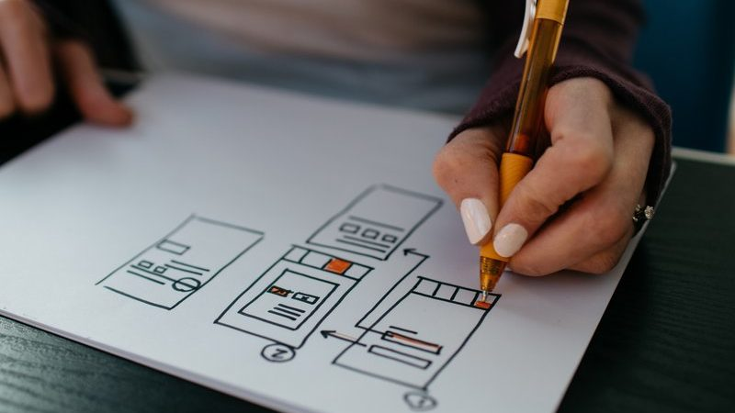
Design
The design phase decides how the system will operate in terms of the hardware, software, and network infrastructure that will be in place; the user interface, forms, and reports that will be used; and the specific programs, databases, and files that will be needed.
Output : System Specification
Notes:
14 Chapter 1 The Systems Analyst and Information Systems Development
The design strategy must be determined. This clarifies whether the system will
be developed by the company’s own programmers, whether its development will
be outsourced to another firm (usually a consulting firm), or whether the company
will buy an existing software package.
2. This leads to the development of the basic architecture design for the system that
describes the hardware, software, and network infrastructure that will be used. In
most cases, the system will add to or change the infrastructure that already exists
in the organization. The interface design specifies how the users will move
through the system (e.g., by navigation methods such as menus and on-screen
buttons) and the forms and reports that the system will use.
3. The database and file specifications are developed. These define exactly what
data will be stored and where they will be stored.
4. The analyst team develops the program design, which defines the programs that
need to be written and exactly what each program will do.
This collection of deliverables (architecture design, interface design, database
and file specifications, and program design) is the system specification that is used
by the programming team for implementation. At the end of the design phase, the
feasibility analysis and project plan are reexamined and revised, and another
decision is made by the project sponsor and approval committee about whether to
terminate the project or continue. (

Slide 17
Implementation
Delivery and support of complete system.
System installation and maintenance.
Notes:
The final phase in the SDLC is the implementation phase, during which the system
is actually built (or purchased, in the case of a packaged software design and
installed). This is the phase that usually gets the most attention, because for most
systems it is the longest and most expensive single part of the development process.
This phase has three steps:
1- System construction is the first step. The system is built and tested to ensure
that it performs as designed. Since the cost of fixing bugs can be immense, testing
is one of the most critical steps in implementation. Most organizations
spend more time and attention on testing than on writing the programs in the
first place.
2- The system is installed. Installation is the process by which the old system is
turned off and the new one is turned on. There are several approaches that may
be used to convert from the old to the new system. One of the most important
aspects of conversion is the training plan, used to teach users how to use the new
system and help manage the changes caused by the new system.
3- The analyst team establishes a support plan for the system. This plan usually
includes a formal or informal post-implementation review, as well as a systematic
way for identifying major and minor changes needed for the system.

Slide 18
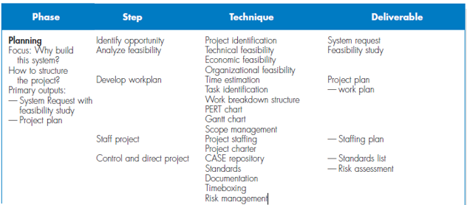
Planning

Slide 19
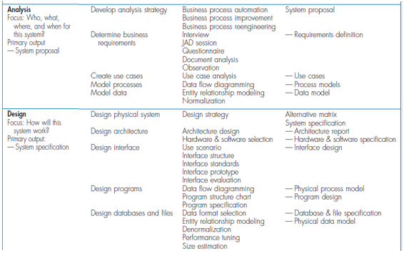
Analysis & Design

Slide 20
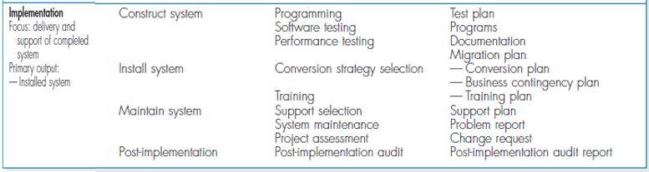
Implementation

Slide 21
Six phases in every Software development life cycle model:
Requirement gathering and analysis
Design
Implementation or coding
Testing
Deployment
Maintenance
Notes:
http://tryqa.com/what-are-the-software-development-life-cycle-sdlc-phases/

Slide 22
Requirement gathering and analysis
Meetings with managers, stake holders and users are held in order to determine the requirements.

Slide 23

These are general questions that get answered during a requirements gathering phase.
Who is going to use the system?
How will they use the system?
What data should be input into the system?
What data should be output by the system?

Slide 24
Output
Finally, a Requirement Specification document is created which serves the purpose of guideline for the next phase of the model.

Slide 25
Design
In this phase the system and software design is prepared from the requirement specifications which were studied in the first phase.
System Design helps in specifying hardware and system requirements and also helps in defining overall system architecture.
The system design specifications serve as input for the next phase of the model.

Slide 26
Implementation or coding

Slide 27
Testing

Slide 28
Deployment

Slide 29
Maintenance

Slide 30
Why SDLC ?
For better software quality,
Make the goals of the software clear to the team (developers know what to build and testers know what and how to test)
Reduce the rate of vulnerabilities (fewer or none)
Management control.
Effective documentation and reduced dependencies
Effective resource utilization.
Effective cost and time definition.
Ensure the architecture and design are secure.
Define and adhere to the set processes and objectives.
Meet and exceed Customer’s expectations.
Notes:
http://tryqa.com/software-development-life-cycle-sdlc/

